Slide 1
Lockpicking
Lockpicking (0-100) vs difficulty (0-110)
Equal skill = 50% chance of success
Failure = lost lockpick
Takes 10-20 seconds
Player skill is equivalent to 10-20 skill points

Slide 2
Lockpicking
Describe each part in detail
As if the person reading would have to implement it
How does it meet the goals?
Bullet point are fine
Diagrams/mockups are great!
What is the player experience?

Slide 3
Tower Defense
Connect mechanics and aesthetics
Focus on roles
What strengths and weaknesses do they have?
Give relative details (damage, speed, etc.)

Slide 4
Minecraft
Brainstorming – done!
Evaluation
Proposal (design brief)
Notes:
Bring up the shared doc you used last time

Slide 5
Evaluate
Technical feasibility
Market opportunity
Artistic considerations
Business/cost restrictions

Slide 6
Evaluate – First Pass
Cross out ideas that nobody likes
Don’t delete!
If even one person kind of likes it, keep it in
Go super fast

Slide 7
Evaluate – Deep Dive
Identify player motivation(s) for each concept
Rough and quick; can divide list
Score on all four categories (0-2)
Technical feasibility
Market opportunity
Artistic considerations
Business/cost restrictions
This gives you an ordered list

Slide 8
Design Brief
Short (1-3 pages)
Proposal for a new feature
Context (if necessary)
Goals
Specifics
Evaluation
Mixture of bullet points and paragraphs
Allows for response from other teams (programmers, artists, producers, etc.)

Slide 9
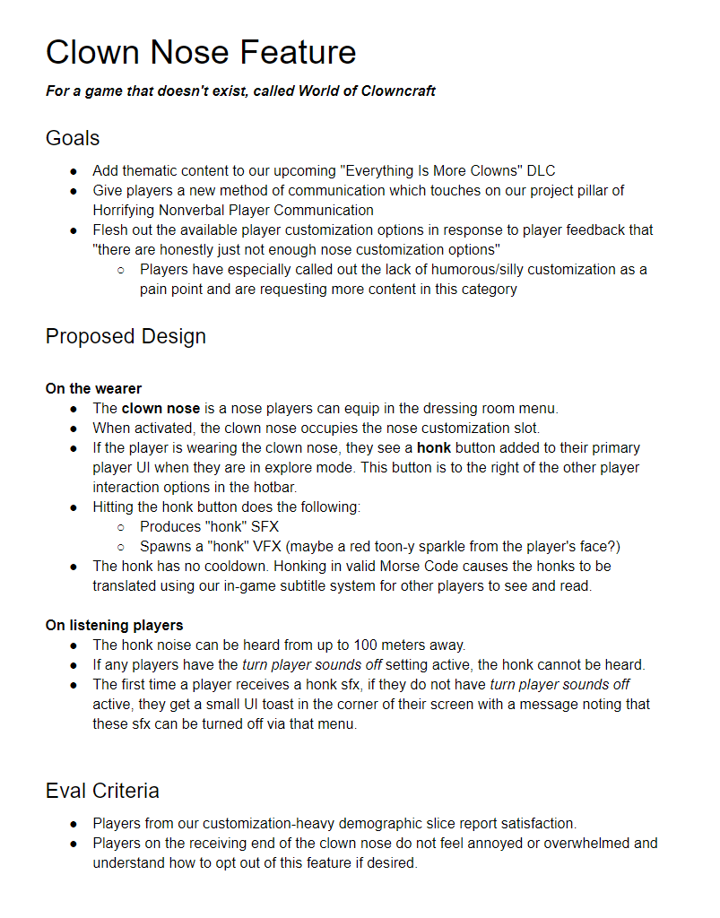
Notes:
From Katie Chironis

Slide 10
Context
Depends on audience

Slide 11
Goals
High-level
Broad
Clearly good
Tied to design pillar
Tied to requirement

Slide 12
Proposed Design
Specific
Bullet points + sentences
If it’s a change, summarize existing state
Include all details you know
Don’t waffle!
No “may”, “can”, “like”

Slide 13
Evaluation Criteria
SMART
Specific
Measurable
Actionable
Related
Time-bound
Address goals
Process

Slide 14
Responses
Scope (engineering)
Production times
Etc.

Slide 15
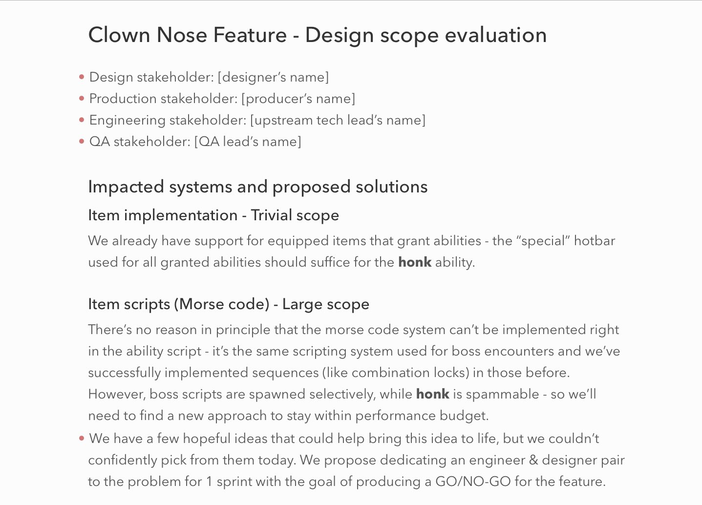
Notes:
Jules Glegg, engineer giving scope feedback

Slide 16
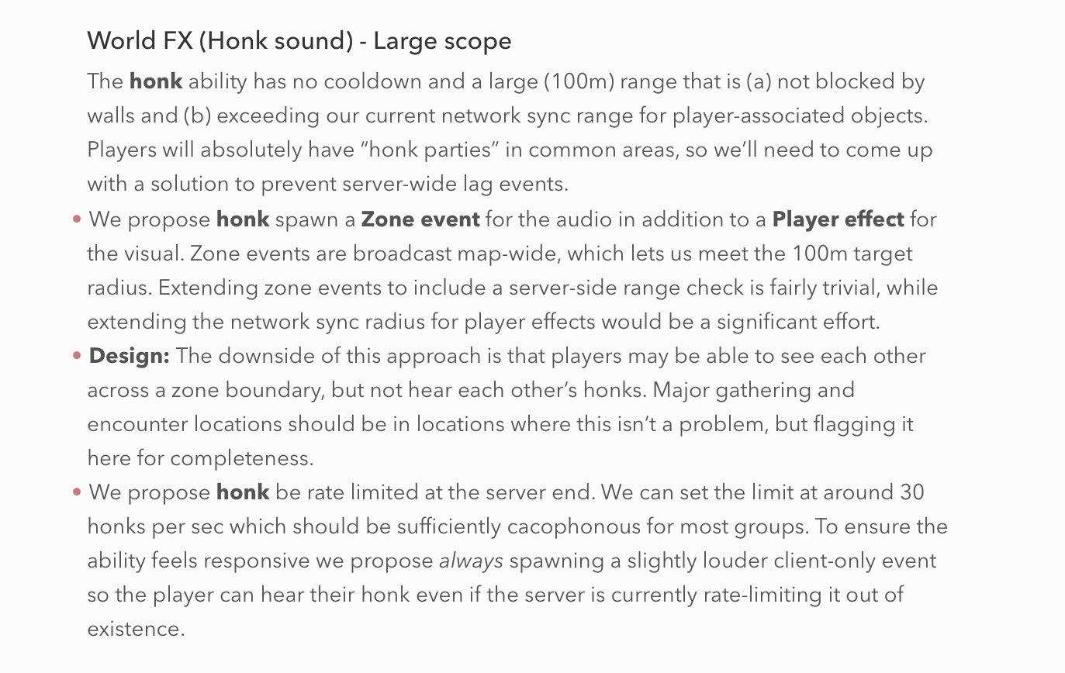
Notes:
Jules Glegg, engineer giving scope feedback

Slide 17
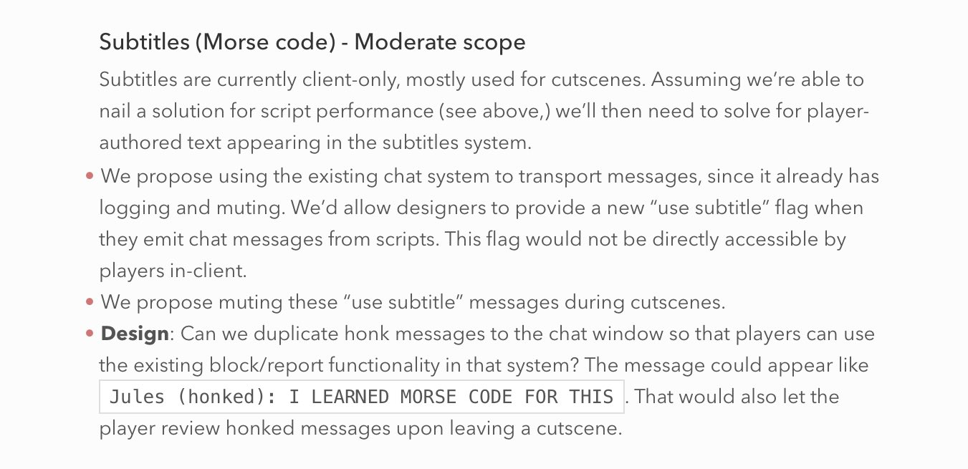
Notes:
Jules Glegg, engineer giving scope feedback

Slide 18
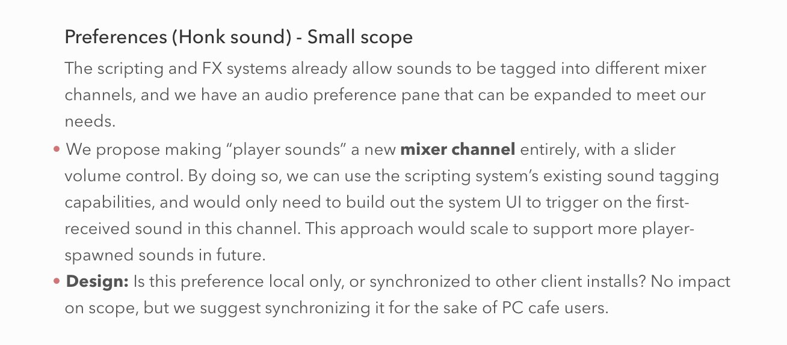
Notes:
Jules Glegg, engineer giving scope feedback

Slide 19
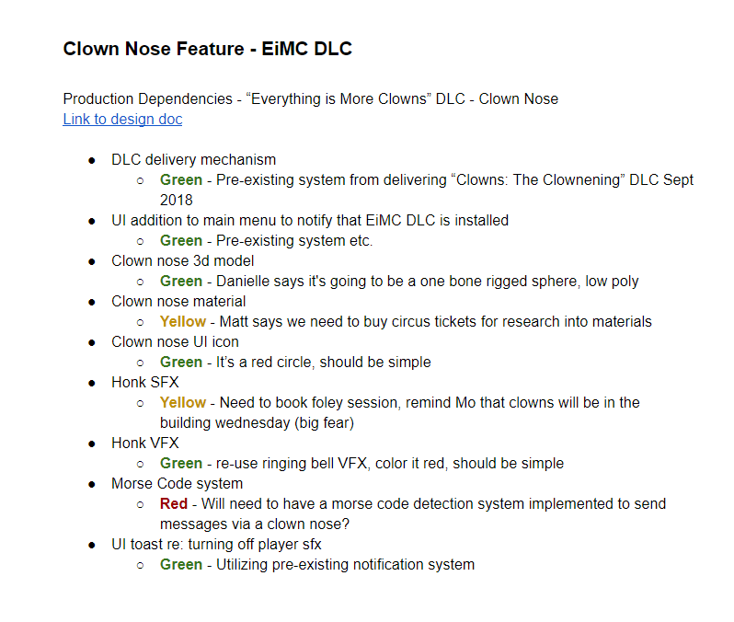
Notes:
Shayna Moon, production doc

Slide 20
Minecraft Design Brief
Identify your goals
From last class
Pick a feature you brainstormed & evaluated
Don’t need to pick the same one as the rest of your group
Describe it in as much detail as possible
Describe how you’ll know if it meets your goals
Often addresses potential drawbacks as well

Slide 21
Reminders
Minecraft Design Brief
Start thinking about a digital design

